Slide 1
Fresh Food E-commerce System
–INFO5100 Application Engineer & Dev Final Project Presentation
Presented by
Mengdi Yu (001599192）
Jiawei Qian (002109507)
Huanlin Xiao (001523208)

Slide 2
Ecosystem
Our project forms such an ecosystem, including enterprises or organizations like suppliers, sales, logistics, and customer service. In this way, it reduces the cost management and resource waste caused by communication between different enterprises and organizations.

Slide 3
Problem Statement
The continuousness of COVID-19 has led to an increasing impact on traditional commodity trade. Customers prefer online and non-contact delivery methods. Enterprises need to make full use of e-commerce to realize informatization and modernization management. Although the current online shopping system is relatively mature, there are still many processes that can be simplified for communication and cooperation between different enterprises by establishing an ecosystem

Slide 4
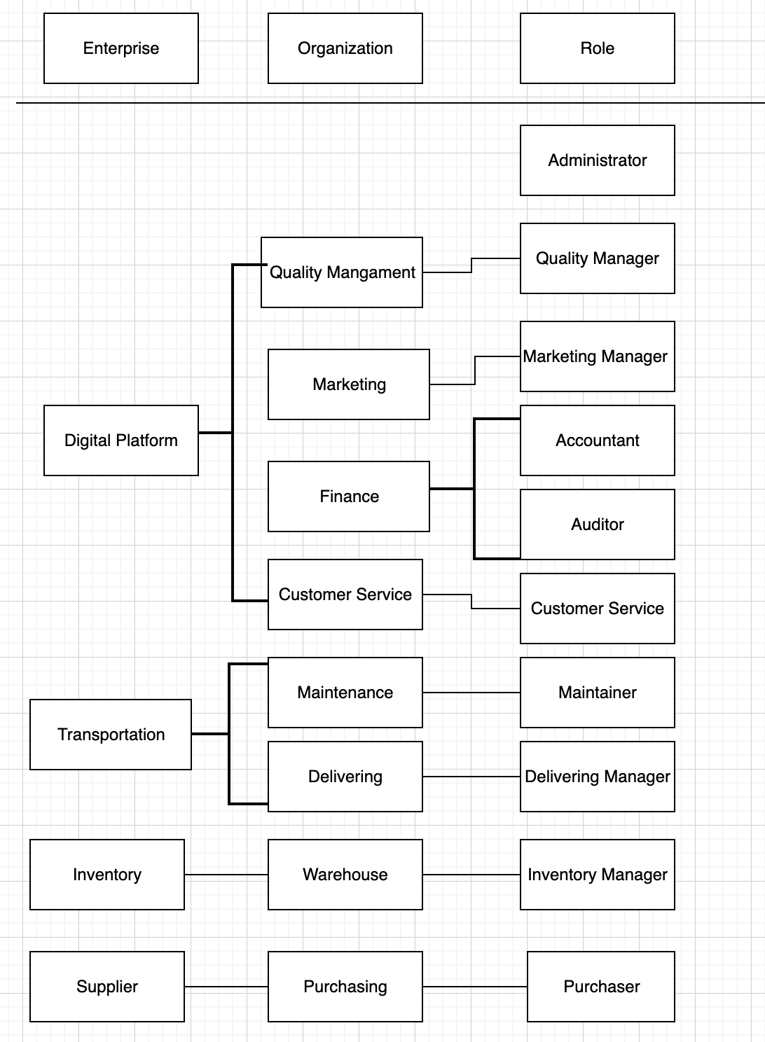

Slide 5
Work Requests
Purchase to market
Customer Buy
Product Delivery
Customer Service Ticket
Order Refund

Slide 6
Creative Points
Role Based Access Control
Order Email Notification
Data Visualization

Slide 7
Tech Stack
Project Dependency Management: Maven
Database: MySQL
Persistence: Hibernate
Visualization Analysis: jfreechart

Slide 8
Thanks for Watching!

